Slide 1
Task 4: Sales Dashboard Design
G.HARISHMA

Slide 2
Objective
To create an interactive sales dashboard
To analyze sales and profit data
To identify trends and performance by region and category

Slide 3
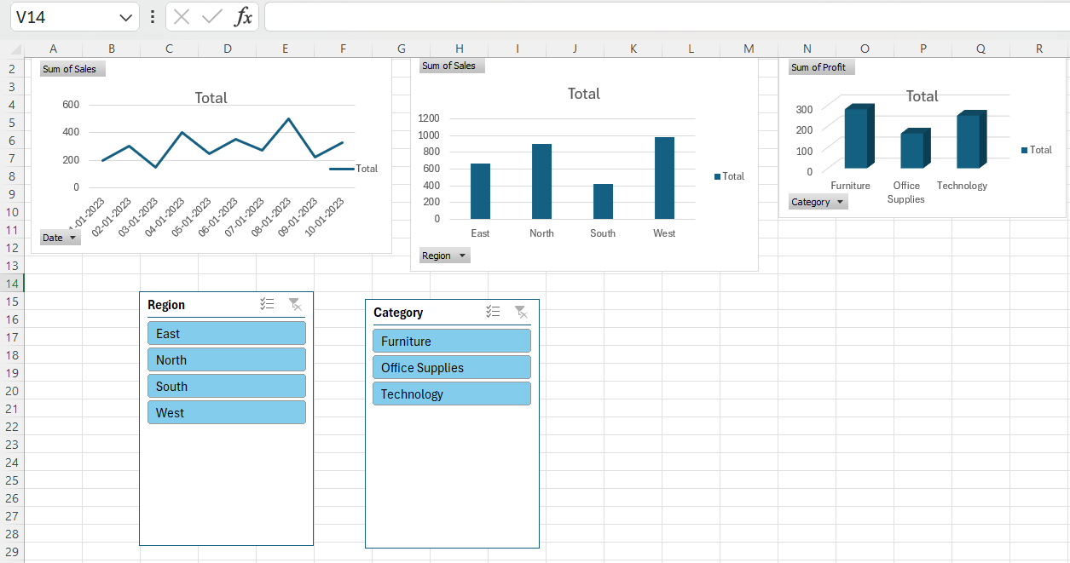

Slide 4
Conclusion
Dashboard provides clear view of sales performance
Helps identify trends and comparisons
Useful for business decision-making

